Slide 1
The Lepton Village Preservation Society
Welcome to the TLVPS website

Slide 2
Who are they and what do they do?
They are a group of Lepton residents who originally worked, as part of Lepton Vision, to develop a Lepton Neighbourhood Development Plan. As a group they worked so well together that they wished to carry on after the LNDP was completed.
So they formed The Lepton Village Preservation Society in order to work for the improvement f Lepton Village for its residents.

Slide 3
How long have they been established?
The Society was established with a constitution in April 2021

Slide 4
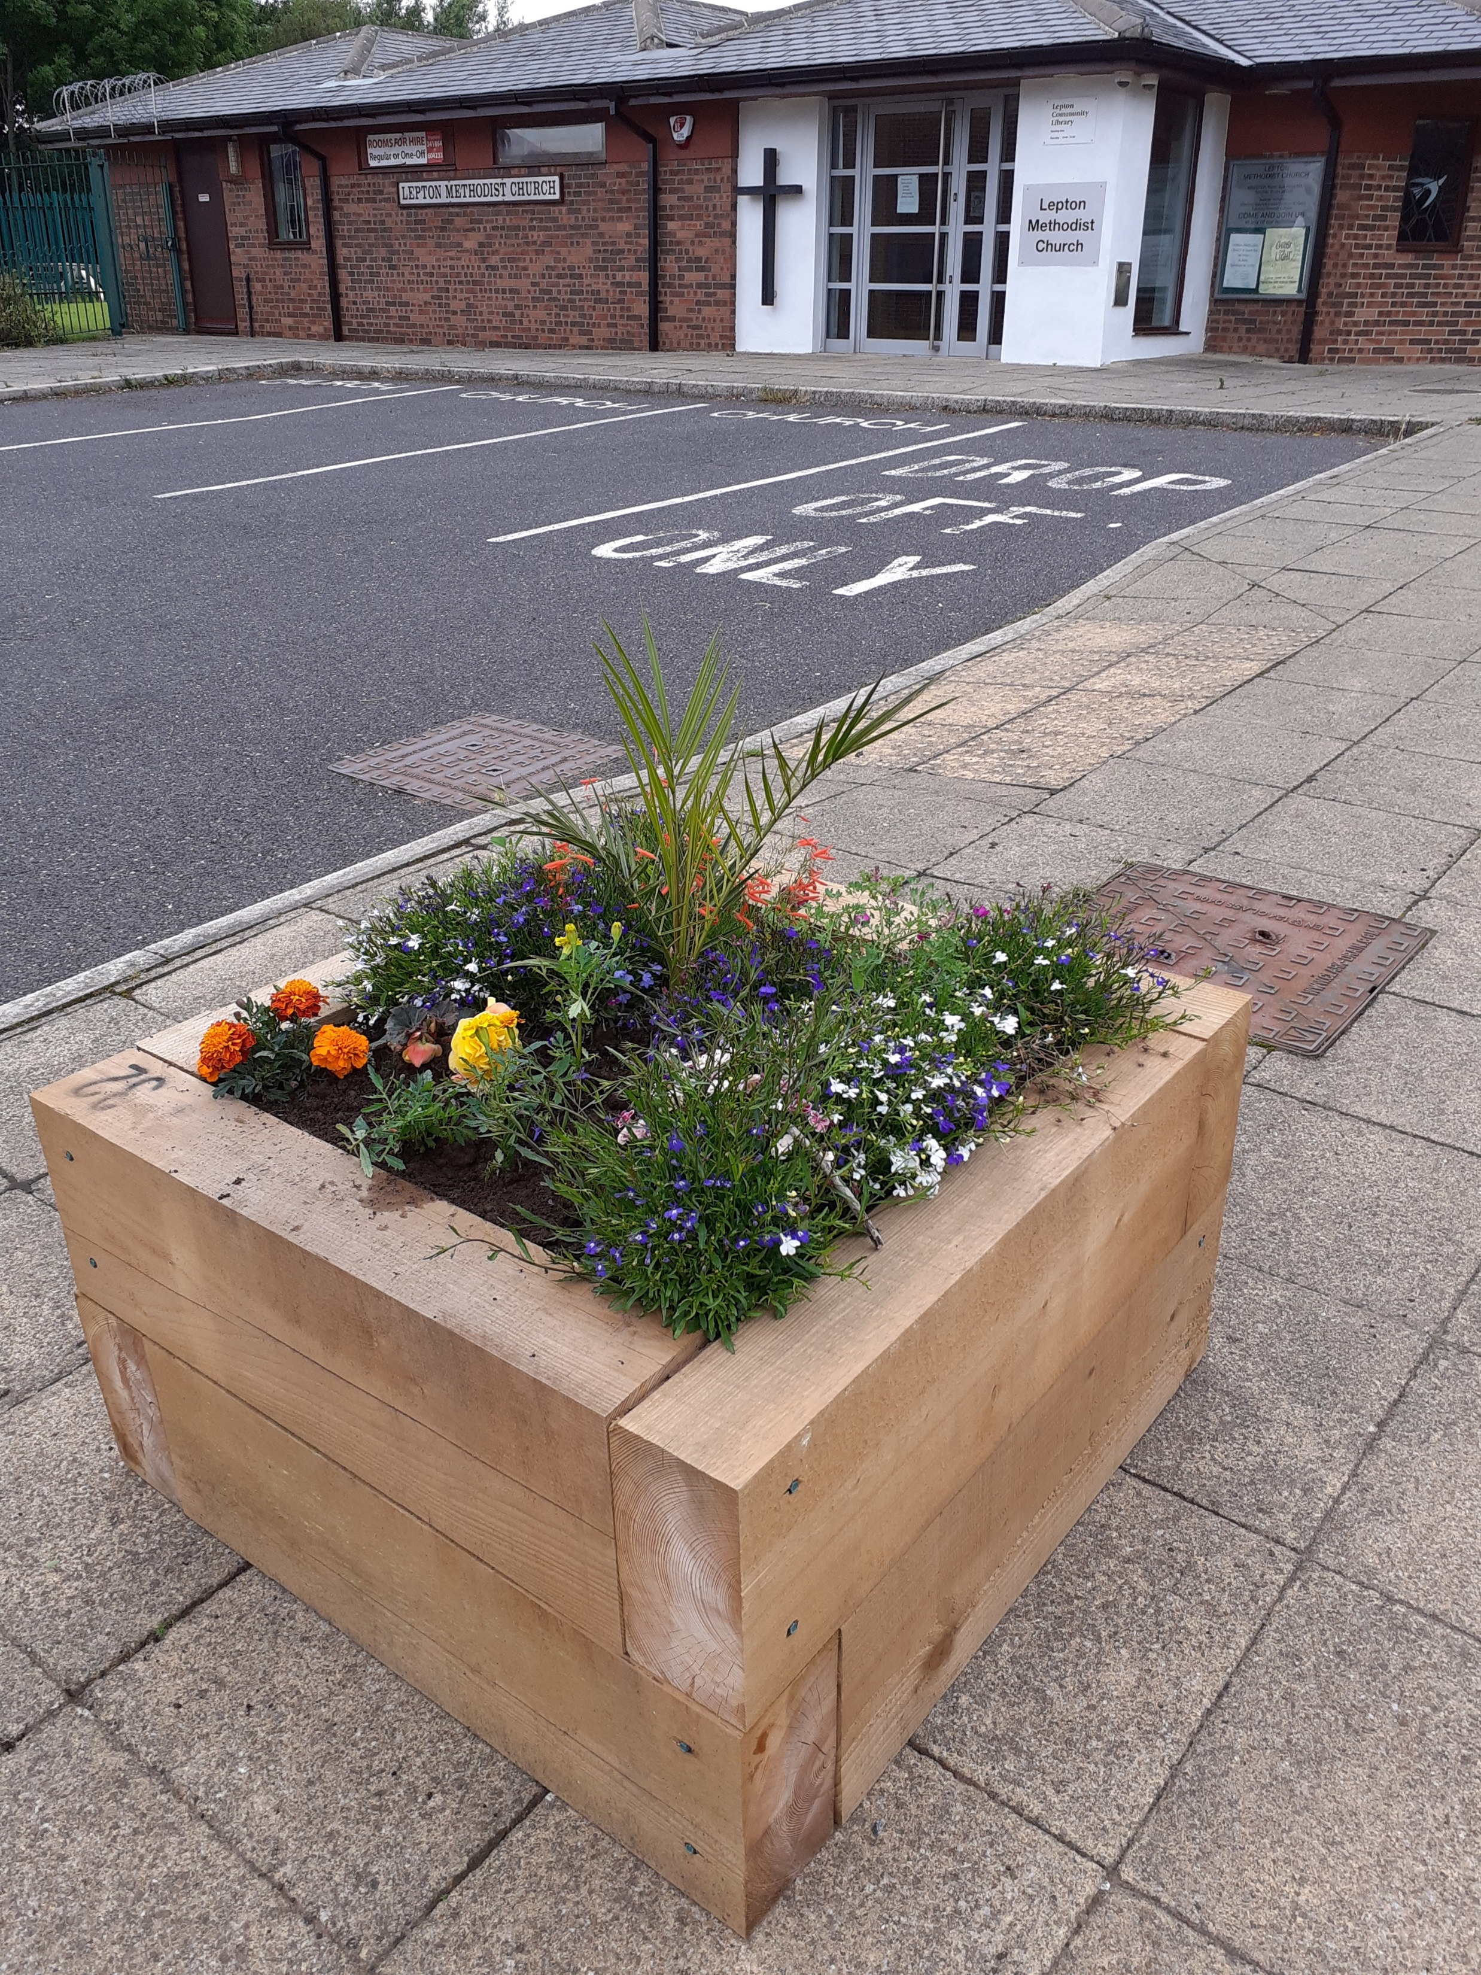
What have they achieved?
Well, so far they have originated the idea of developing the Lepton Recreation Ground into a Memorial Park dedicated to seven people who died in an accident in the fireworks factory during 1944.
They have established a relationship with the two local Schools, joined them for Litter picking and obtained a grant to enable various bulbs to be planted both in the Village Centre and in the Recreation Ground.
They have paid for and had installed the three planters located around the circular car park in the centre of Lepton, established flower beds where there were none and kept them tidy with fresh spring and winter planting.
At the request of Lepton Methodist Church Stewards they have paid for the planting of two lilac trees in the church memorial garden.

Slide 5
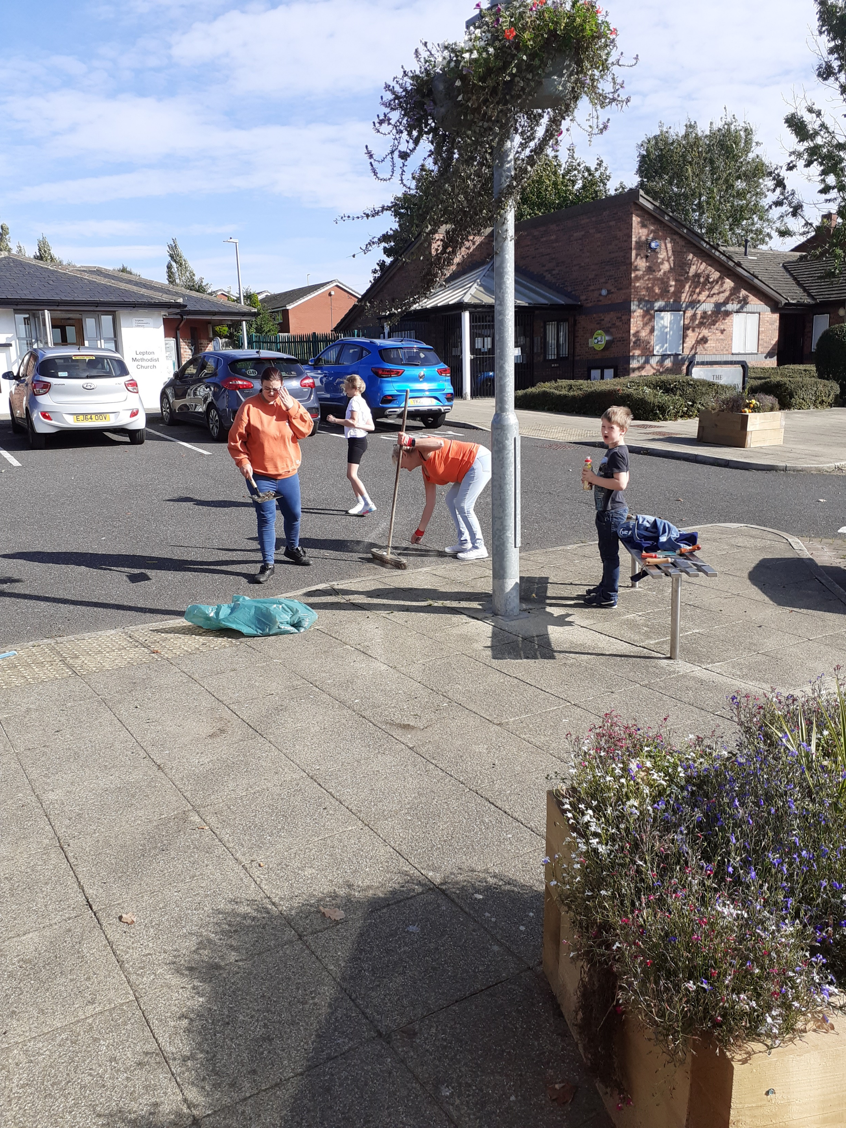
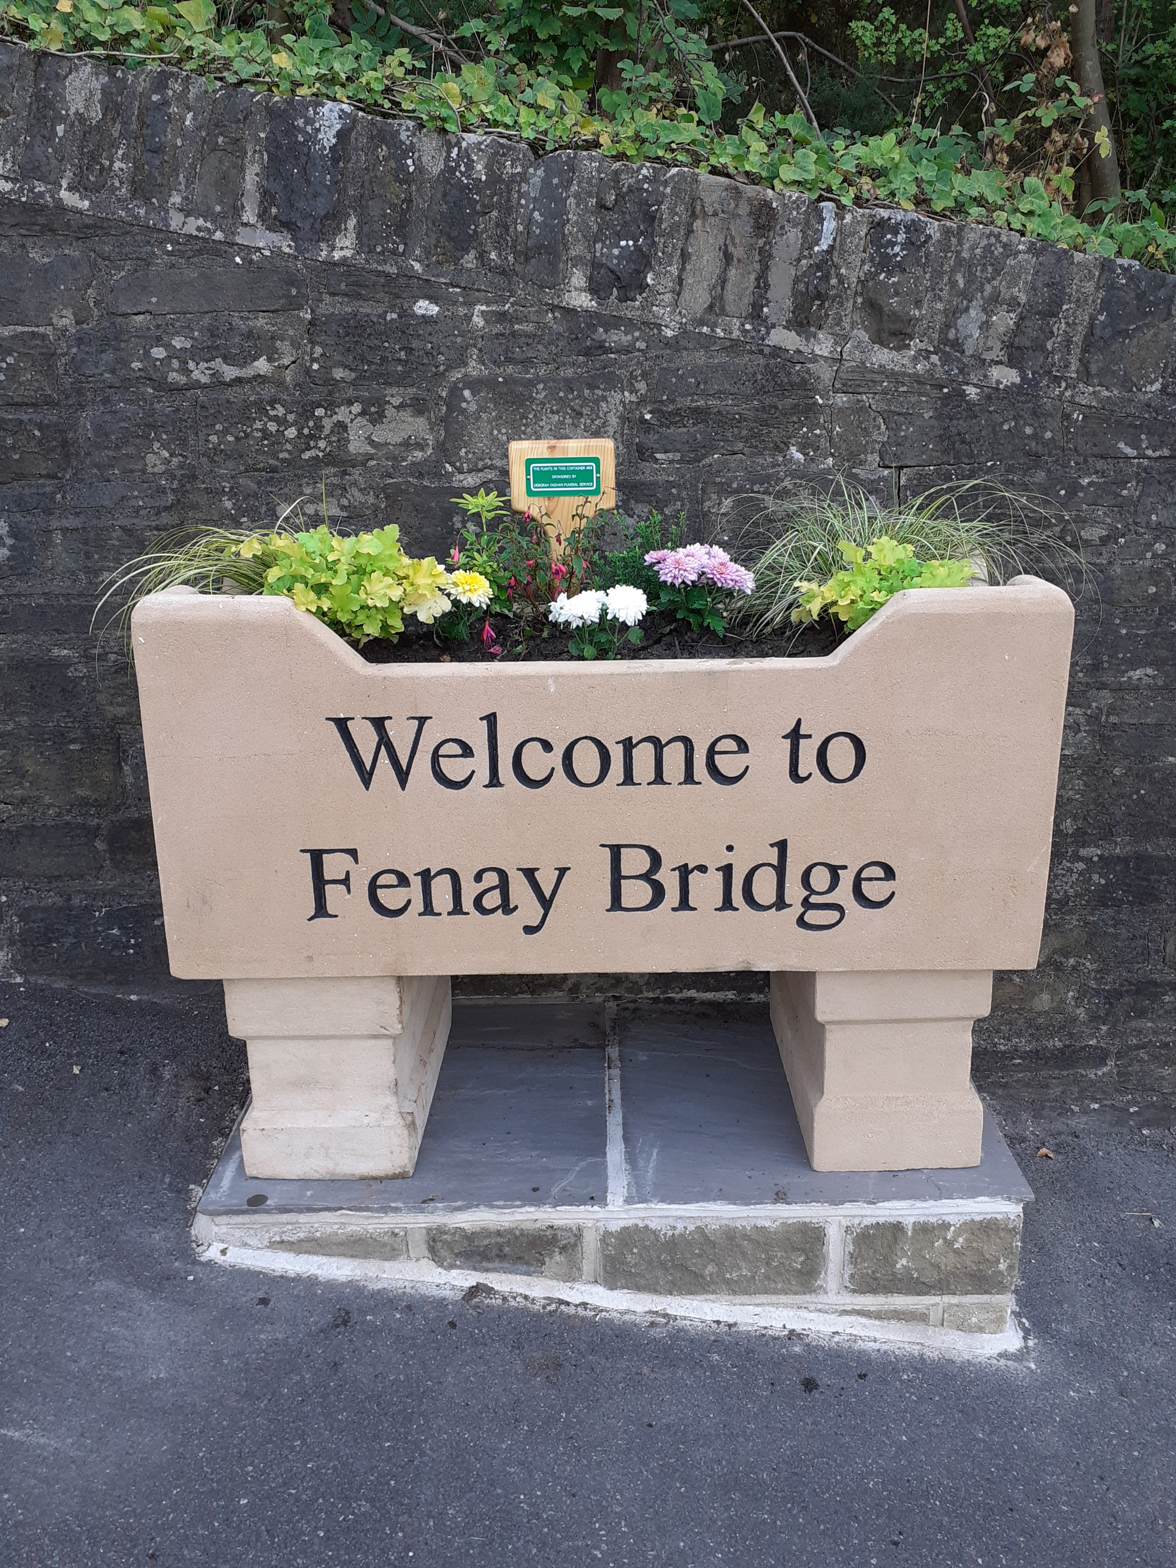
What else?
They have arranged weeding sessions with local volunteers.
Arranged funding for, obtained and installed three name stones/planters around the periphery of the Village. Obtained sponsorship from local Companies and Families so that the planters can be kept fresh with plants all the year around.
At the moment a grant has been obtained from Natural Kirklees to provide a Willow sculpture of a deer for location in the Lepton Recreation ground. Currently they are working with the Lepton Community Orchard Group and Lepton Link to obtain Council permission to install the deer long with more seating, a memorial tree (to the late Queen) and a blossom circle.

Slide 6
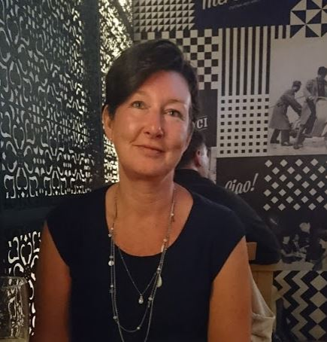
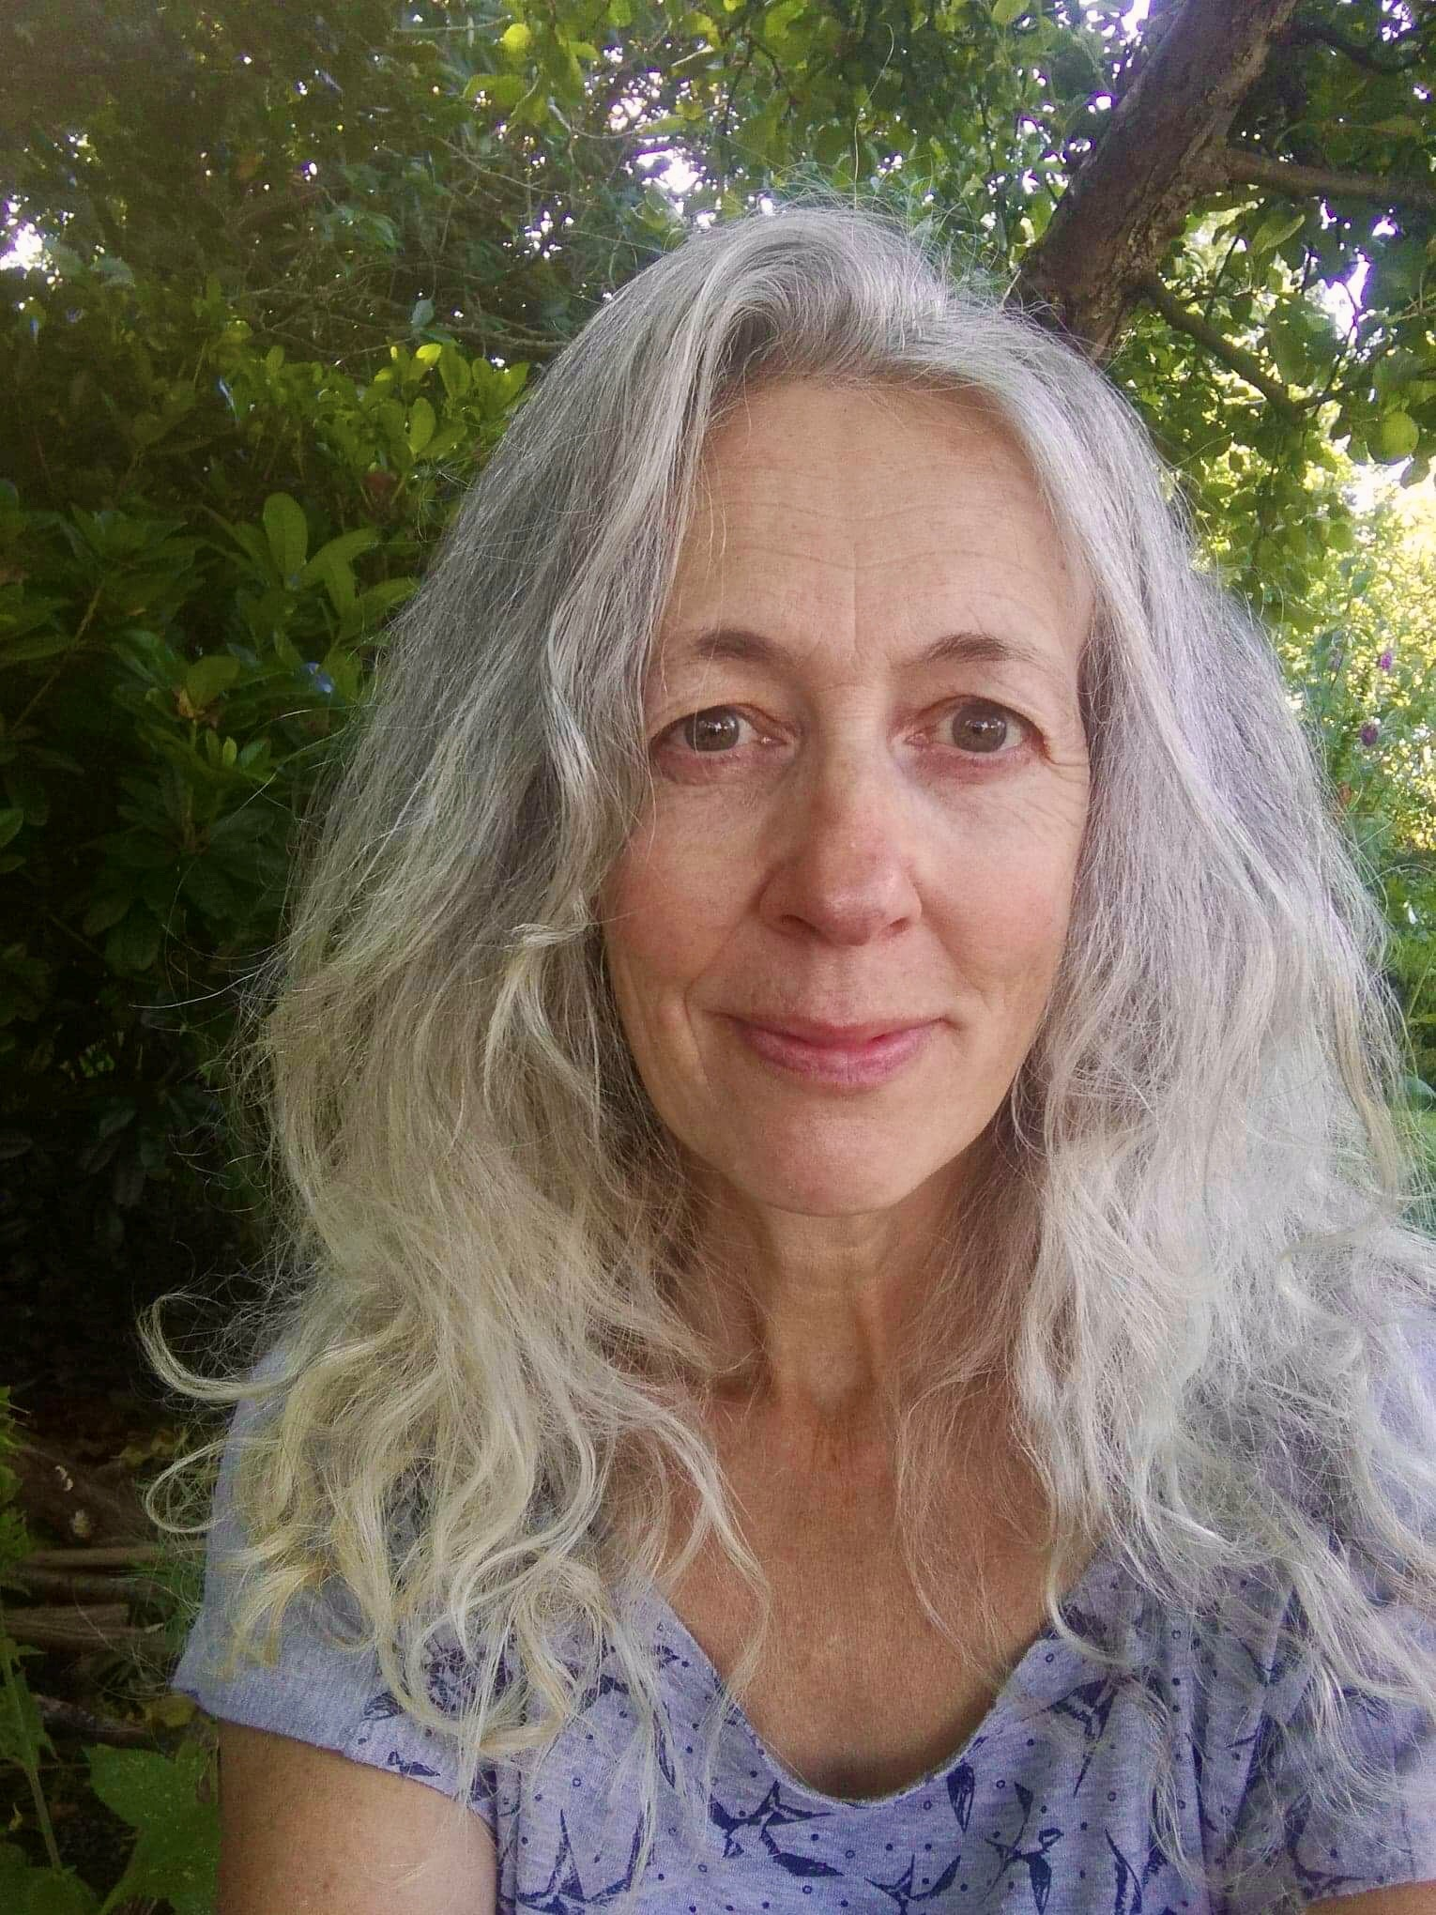
Who are the members?
Currently the members are:
Anne Littlewood – Chairperson
Jude Harding (Artifaces)

Slide 7
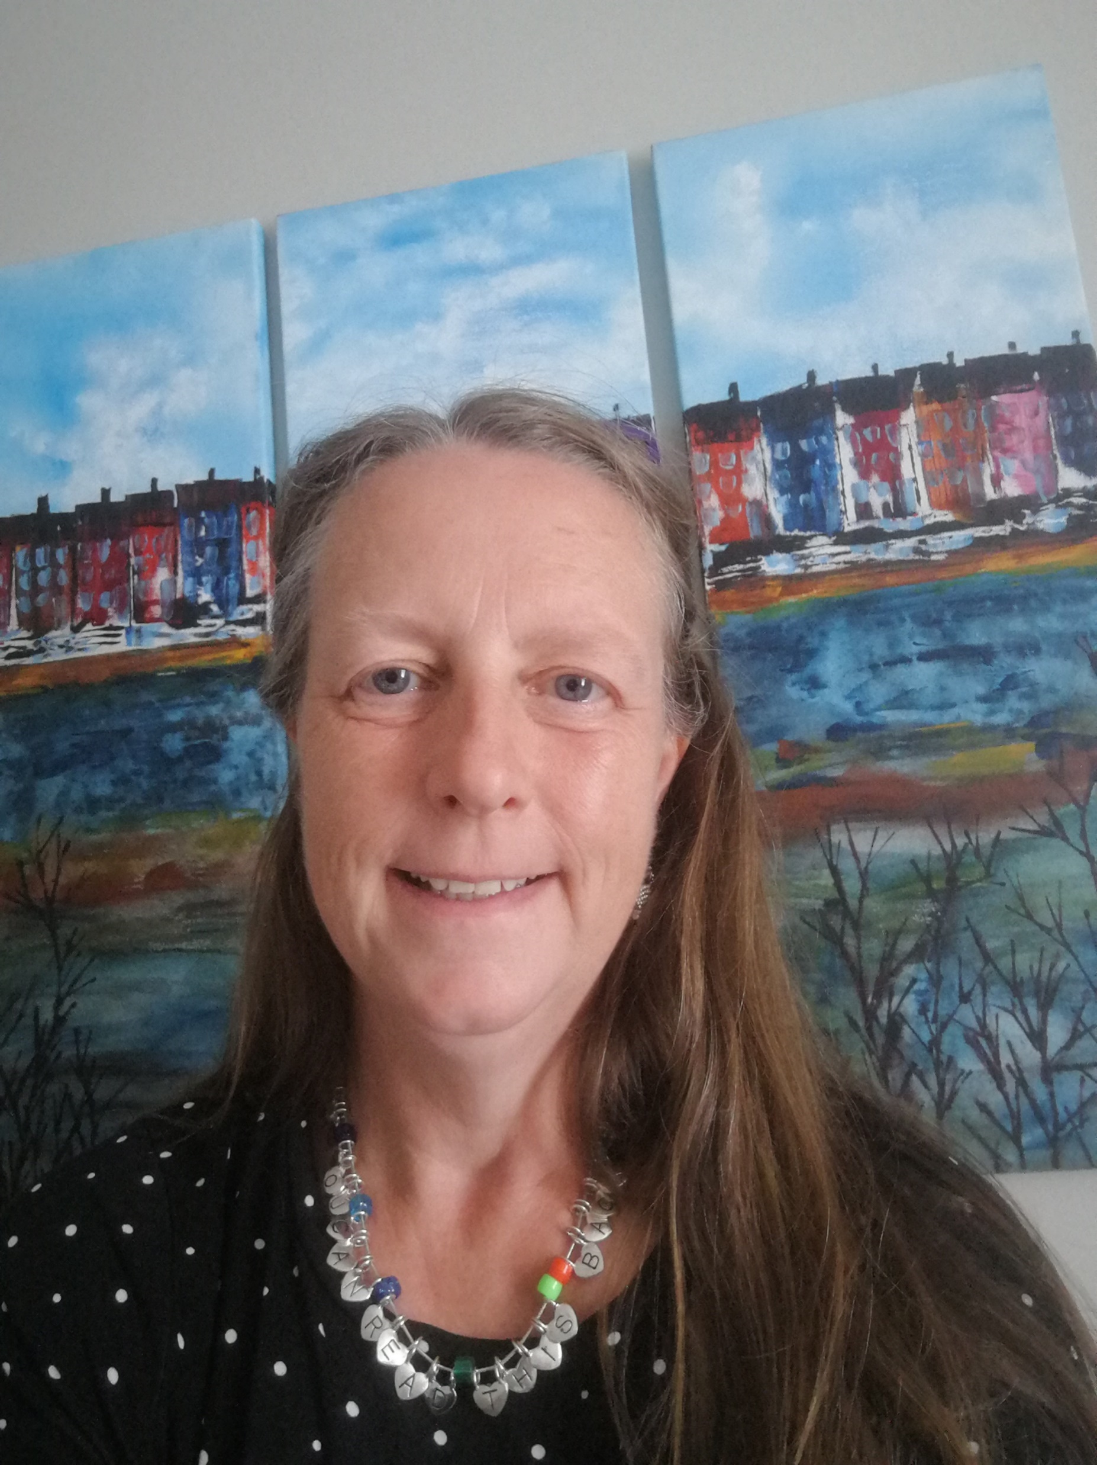
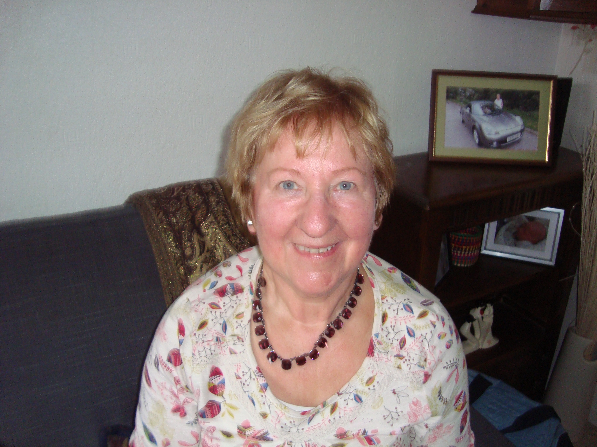
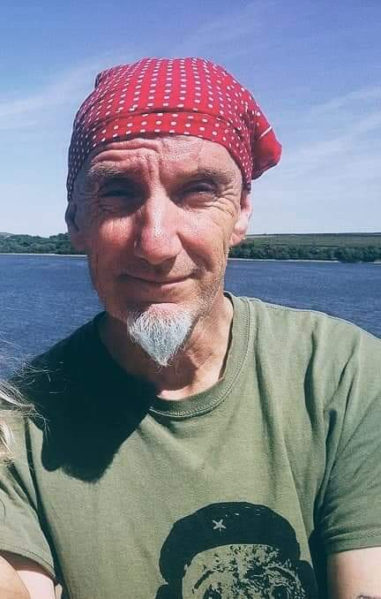
Members contd….
Denise Oukhaba
Mary Smith – Secretary
Michael Birchall

Slide 8
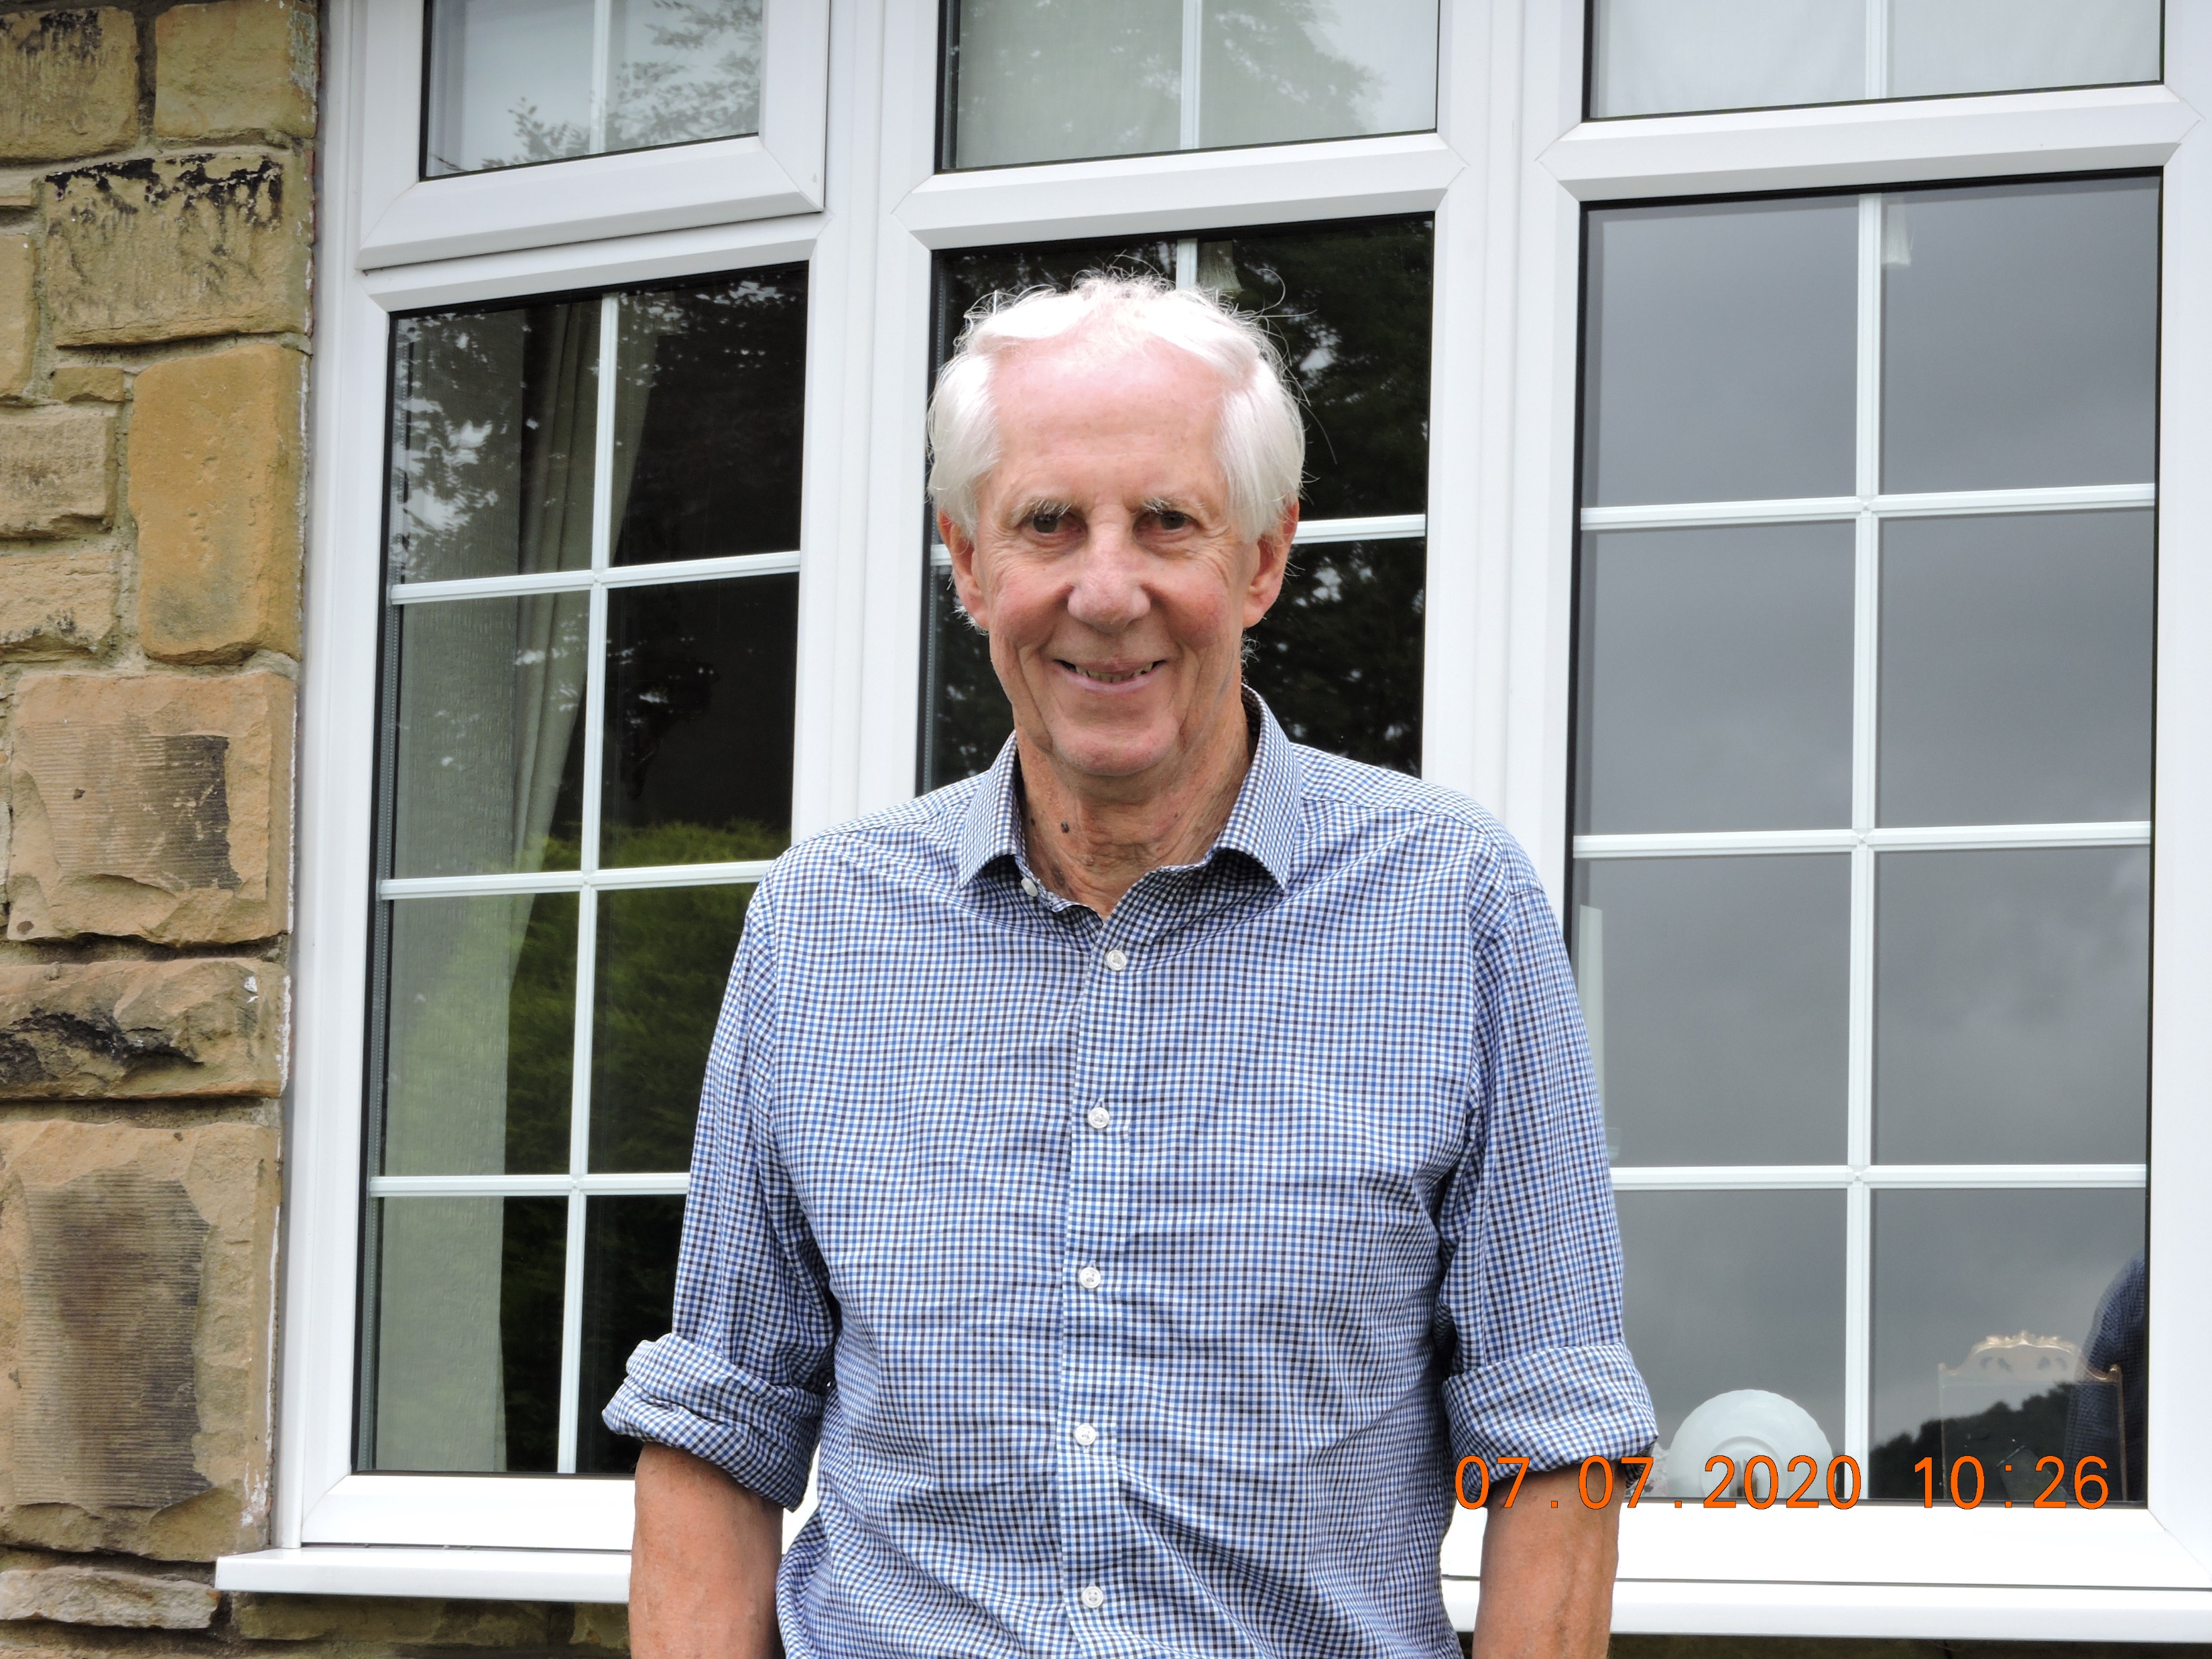
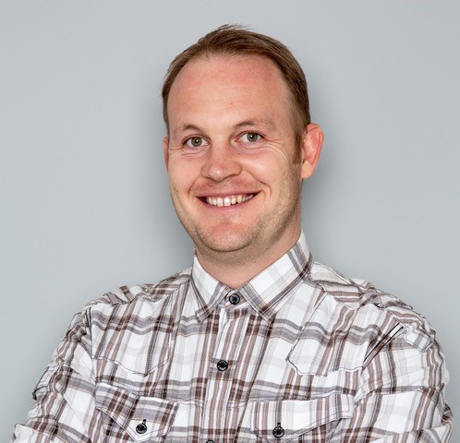
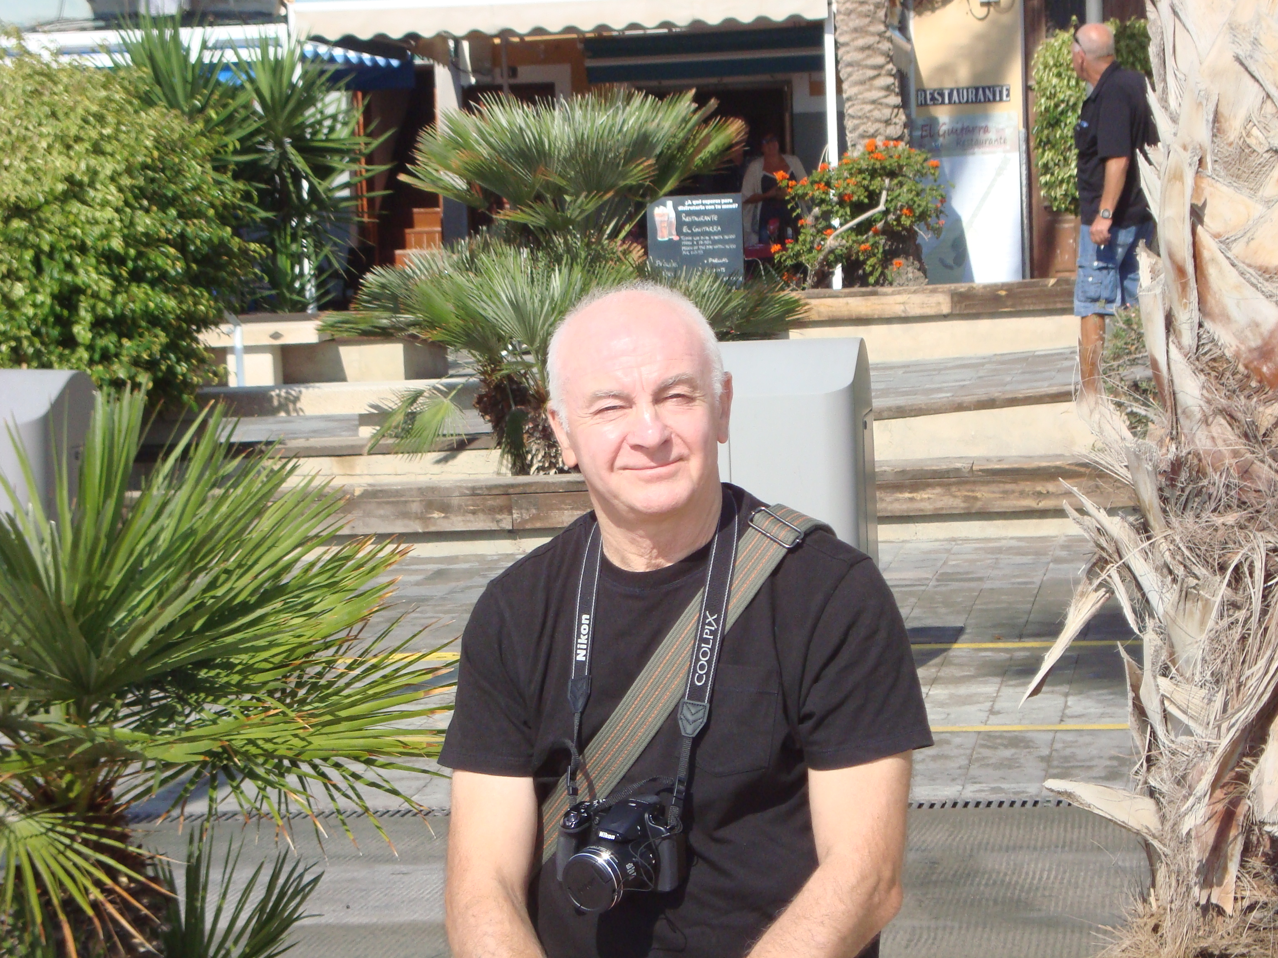
Members contd…
Michael Lilley
James Spivey
Bob Smith - Treasurer

